Slide 1
Hall A Moller Update at the PREX Collaboration Meeting
Simona Malace
JLab
Target Magnet update
Target update
Detector update
DAQ update

Slide 2
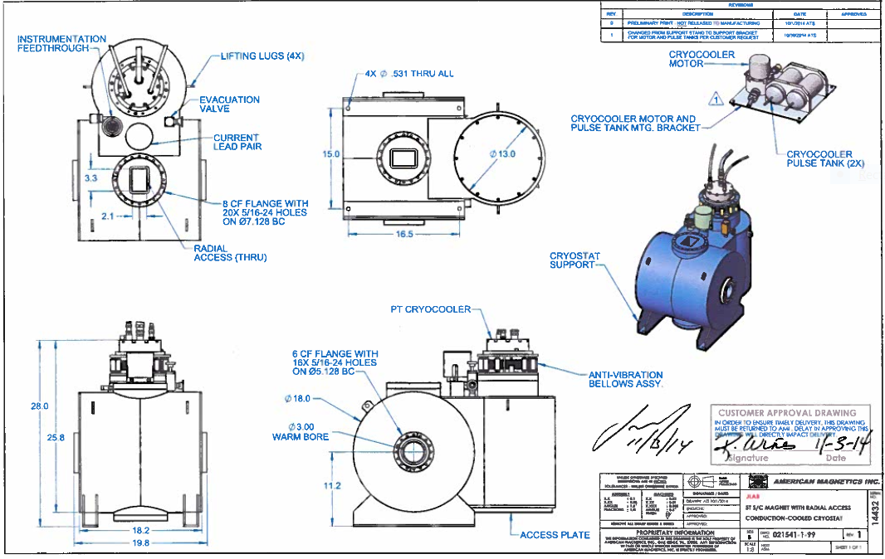
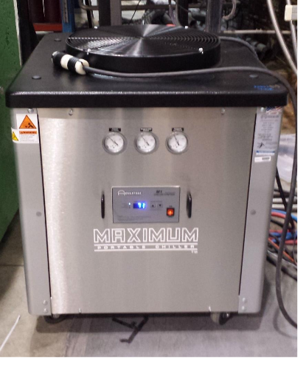
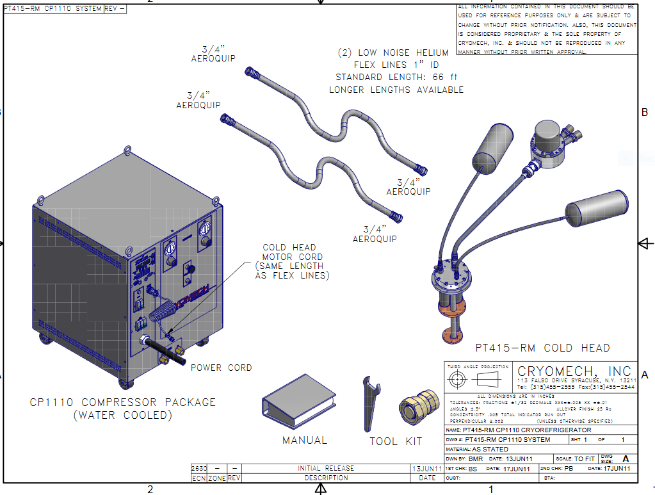
Hall A Moller Update: Target Magnet
→ Used to saturate the Fe foils; field up to 5 T
Split coil, superconducting magnet from American Magnetics
Conduction cooled by a pulse tube cryogenic refrigerator
Water chiller to cool He compressor
T1

Slide 3
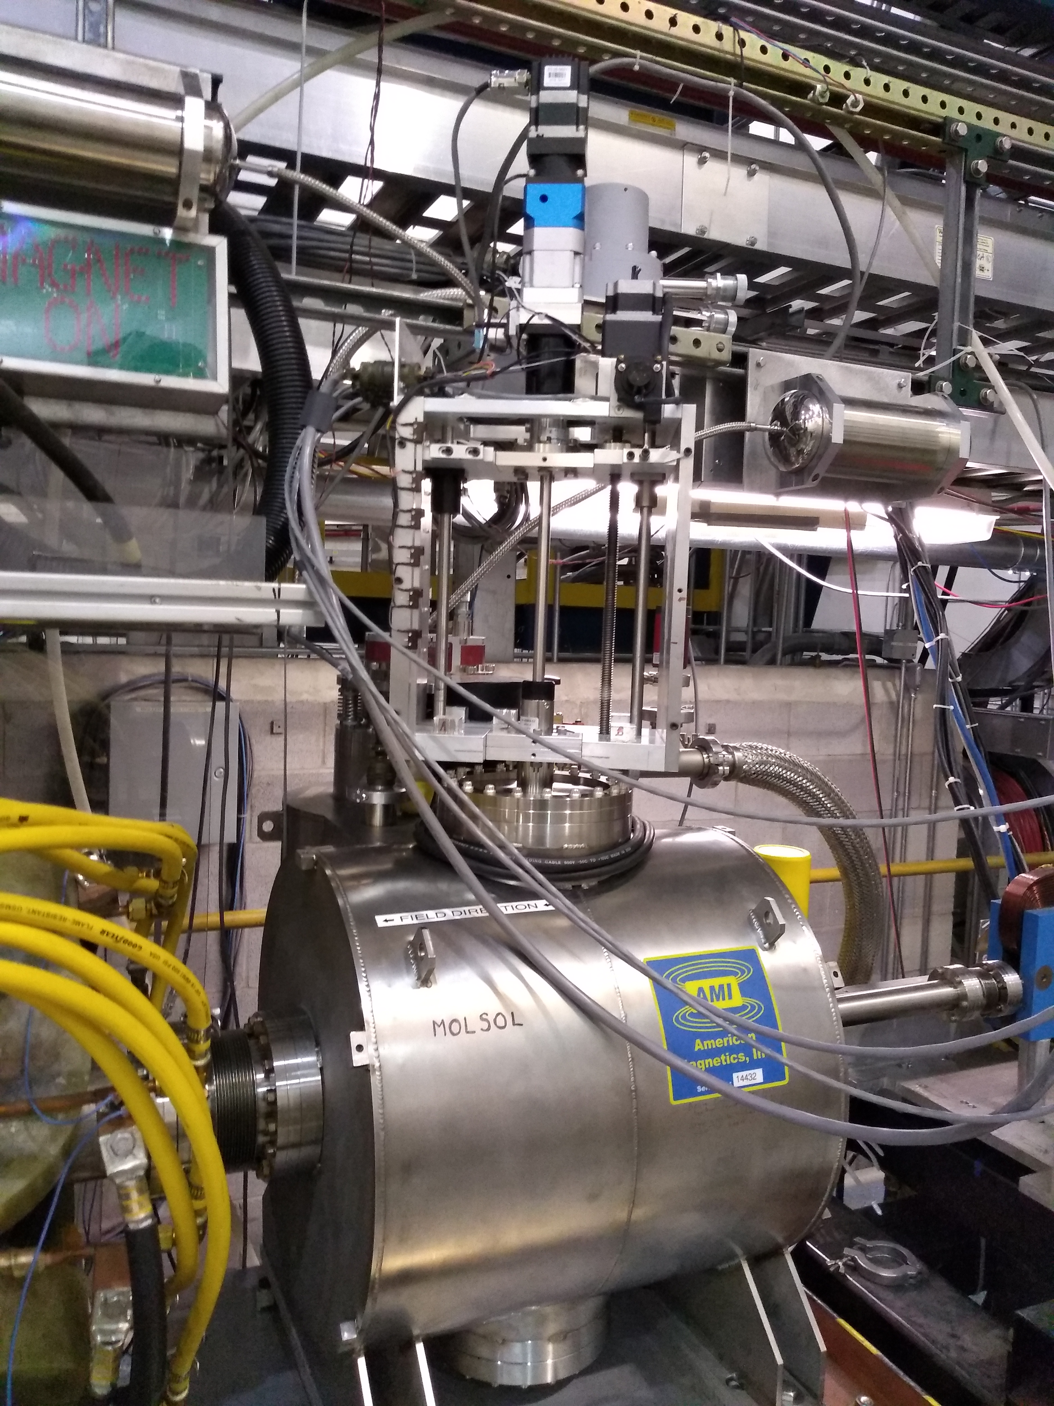
Hall A Moller Update: Target Magnet
Magnet is working, has been tested/used in the ESB and then moved to the Hall in December (Ethan, Javier, Jack made this magnet work)
Installed in the beam line before the holiday shutdown and surveyed and aligned to 300 microns tolerance
It was cooled down during the last week of January (all good)
Javier and I ramped it up to max of 80 A or 4.3 T at the beginning of February
After some training it worked fine

Slide 4
Hall A Moller Update: Target Magnet
Monitor the magnet/magnet system parameters
sensor on cold head
sensor at coils
Pressures on He lines that run from compressor to the cold head
Temperature of water (from air cooled chiller) that cools the He compressor
Operating the magnet
→ Current limited by the power supply to 80.5 A
Ramp rates:
→ from 0 to 80 A: 0.0254 A/s The field to current ratio is: 0.0536 T/A

Slide 5
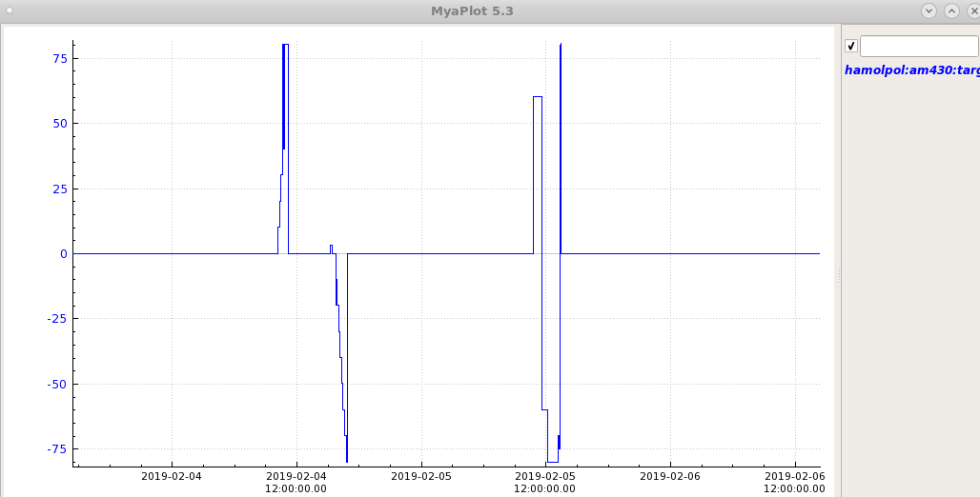
Hall A Moller Update: Target Magnet
Results from testing the magnet in the Hall (first week of February)
quench
all good
quench

Slide 6
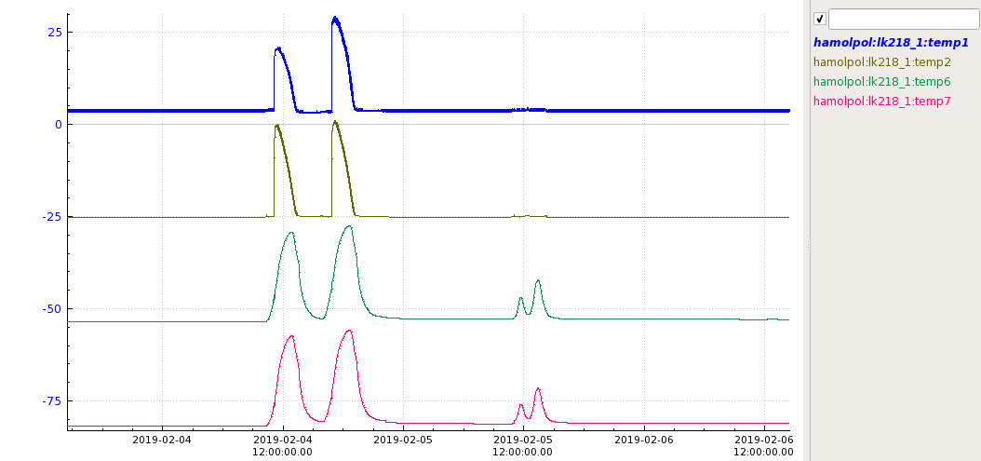
Hall A Moller Update: Target Magnet
cold head
quench
all good
quench

Slide 7
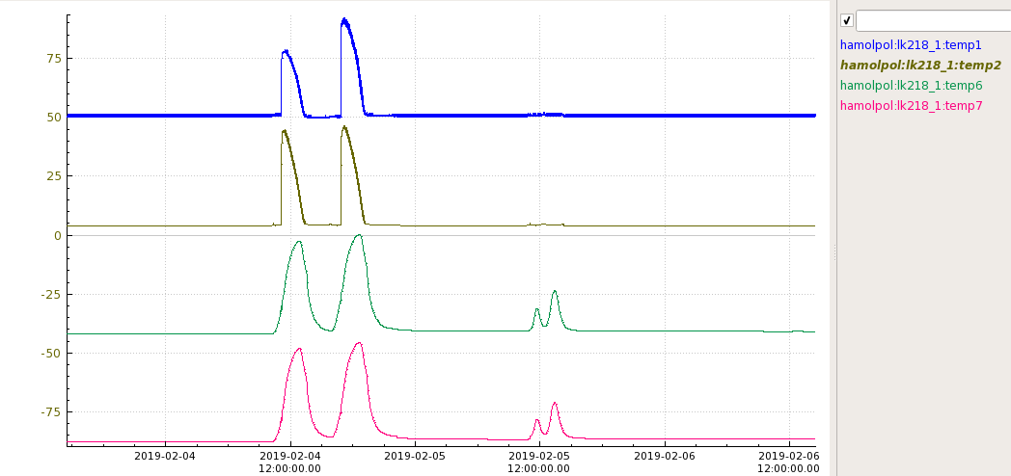
Hall A Moller Update: Target Magnet
coils
quench
all good
quench

Slide 8
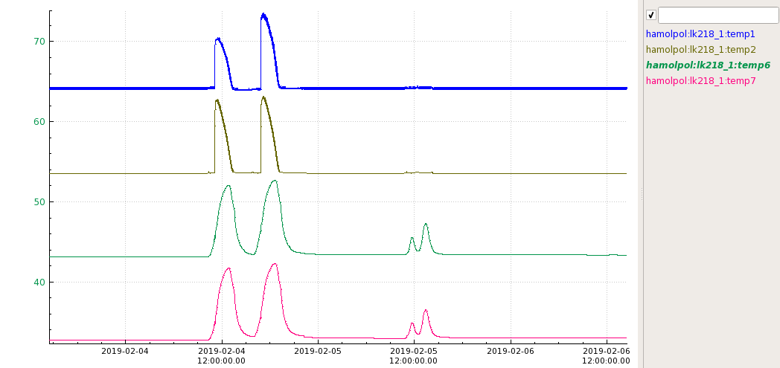
Hall A Moller Update: Target Magnet
leads
quench
all good
quench

Slide 9
Hall A Moller Update: Target Magnet
quench
all good

Slide 10
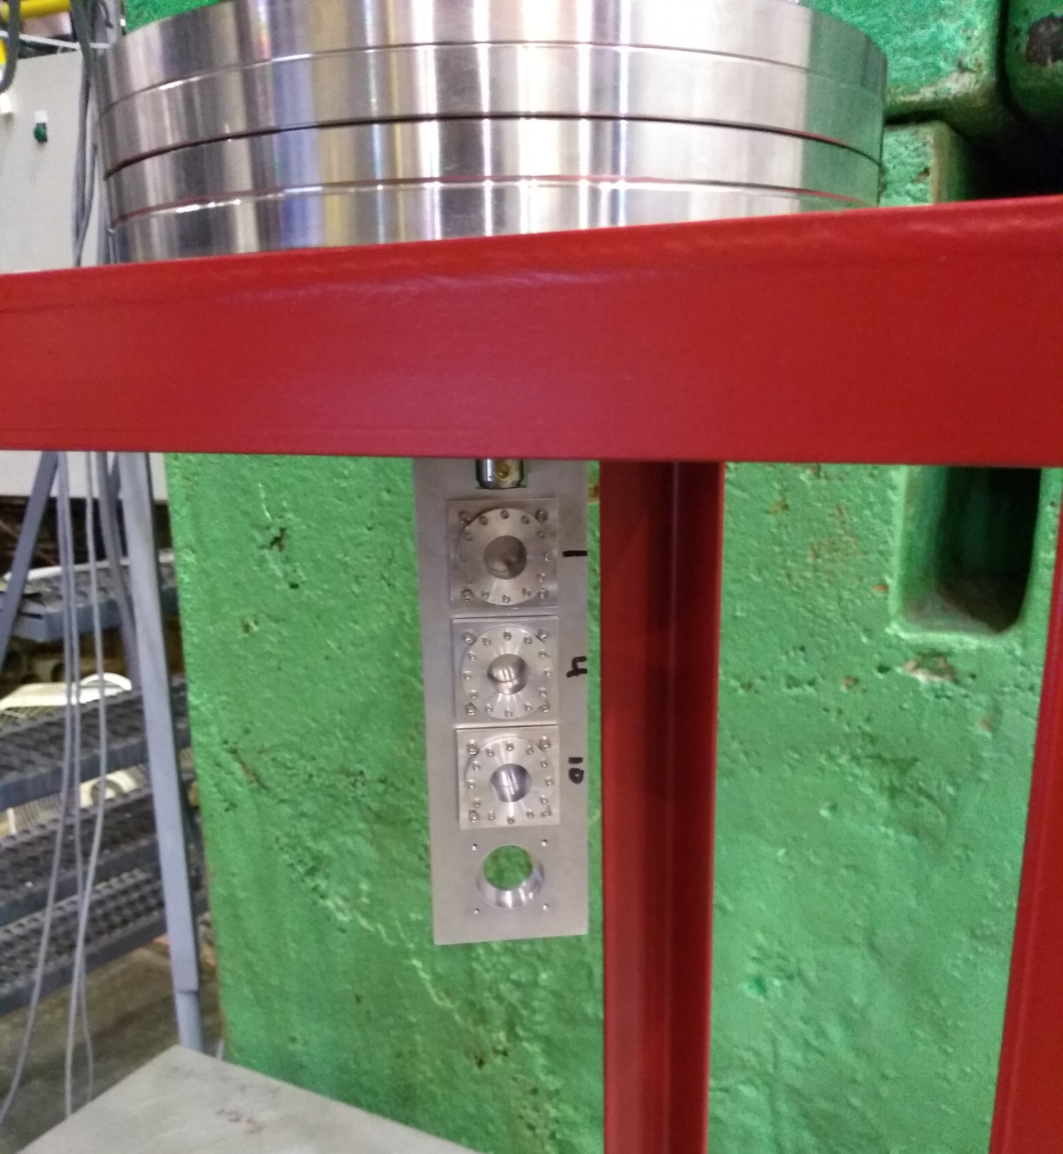
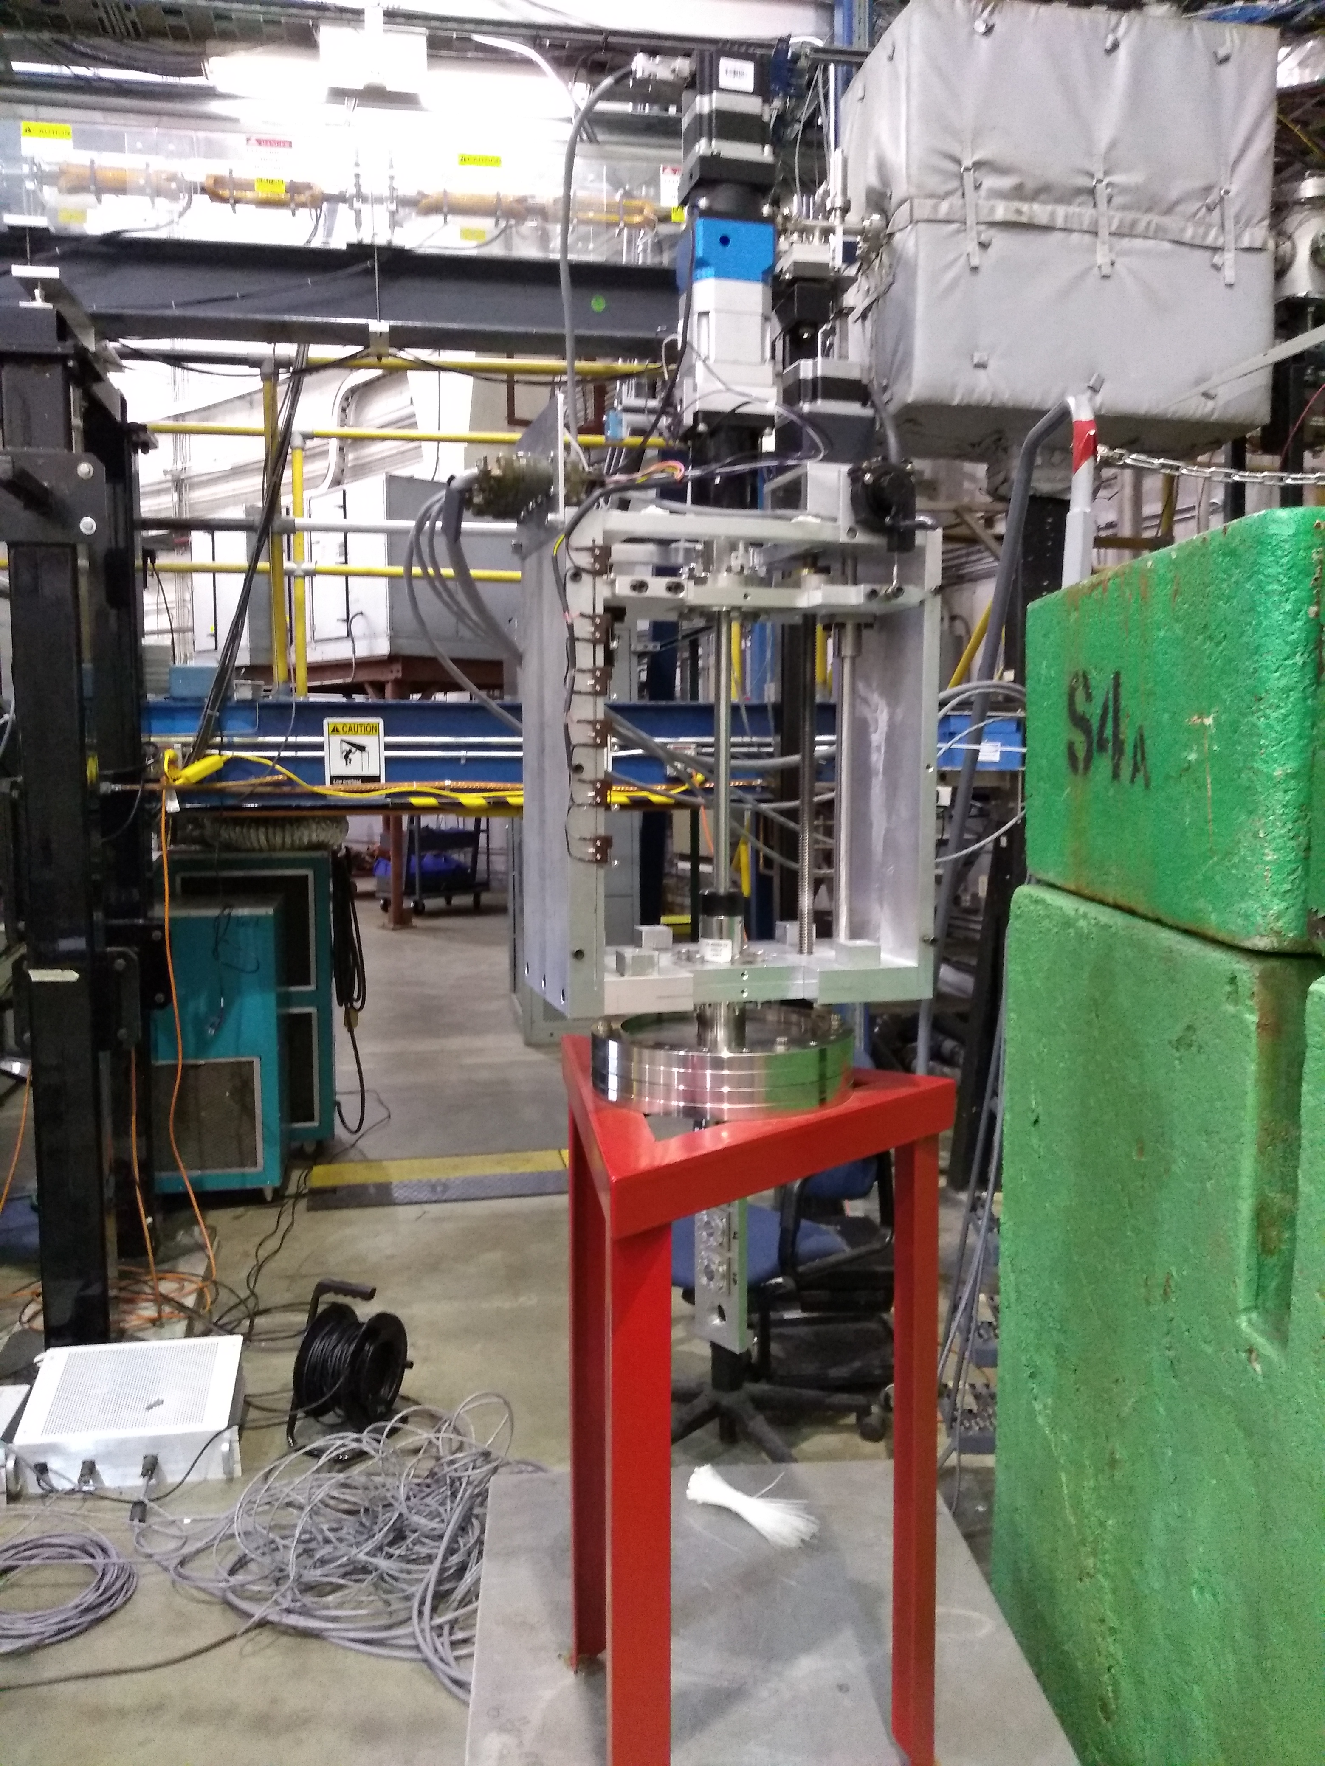
Hall A Moller Update: Target
Target motion system built by Temple U.
(Jim and Bill)
Ladder with 3 Fe foils installed: 1, 4 and 10 microns (1 micron is 99.85 % purity while the other two are 99.99%)

Slide 11
Hall A Moller Update: Target
Foils were installed on the ladder ~the day of survey; target was installed in magnet and vacuum pump down started within ~48 h from foil installation
The ladder and foils were surveyed w.r.t. the beam line
Once target was installed in the magnet very little adjustment was needed to position ladder perp to beam
Target motion software is ready

Slide 12
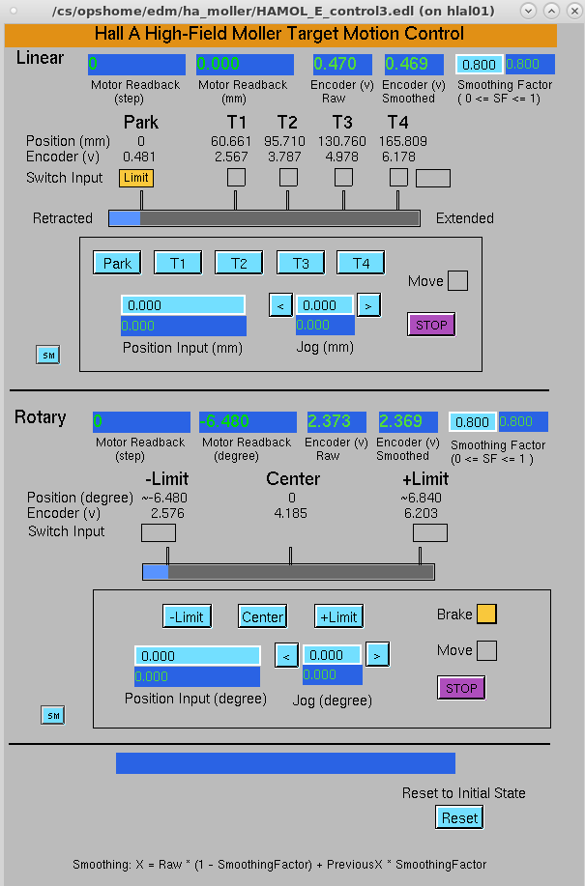
Hall A Moller Update: Target
Movement from foil to foil
Click this to go to center of foil
Use this to go off center of foil
Click this to place foil normal to beam or at min/max angles
Rotation of ladder (foil) w.r.t. beam normal
Use this to go in between

Slide 13
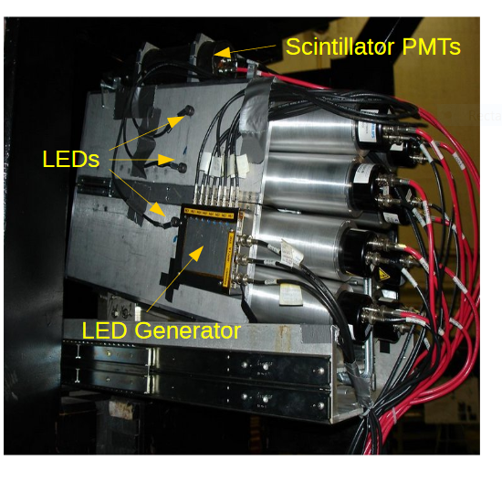
Hall A Moller: Detectors
Scintillators
Calorimeter
Scintillators: 4 paddles per side connected via light guides to Hamamatsu 1 inch PMTs (Hamamatsu R4124)
Calorimeter: lead+scintillating fiber, 2 bocks per side each block connected to two 2 inch PMTs (Photonis XP2282B)

Slide 14
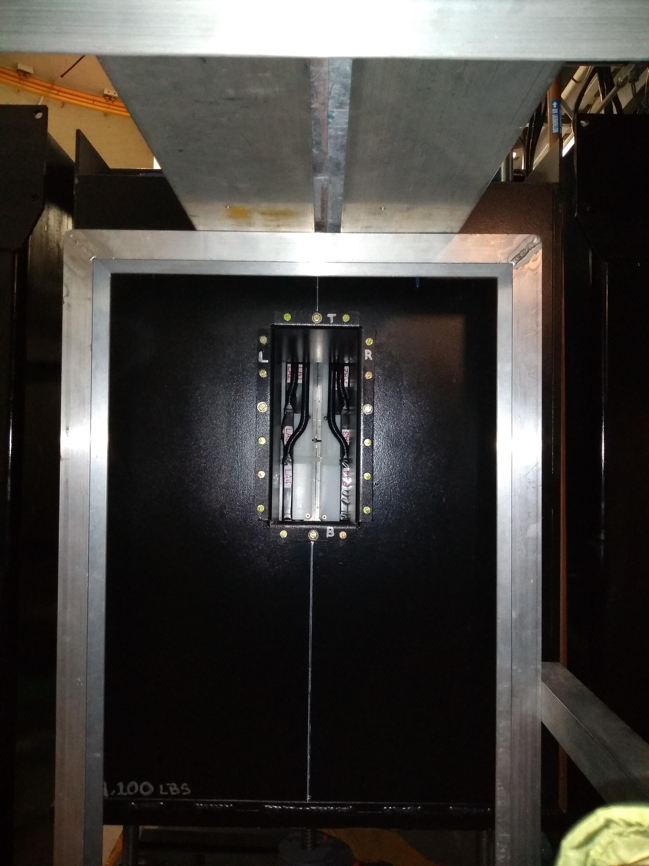
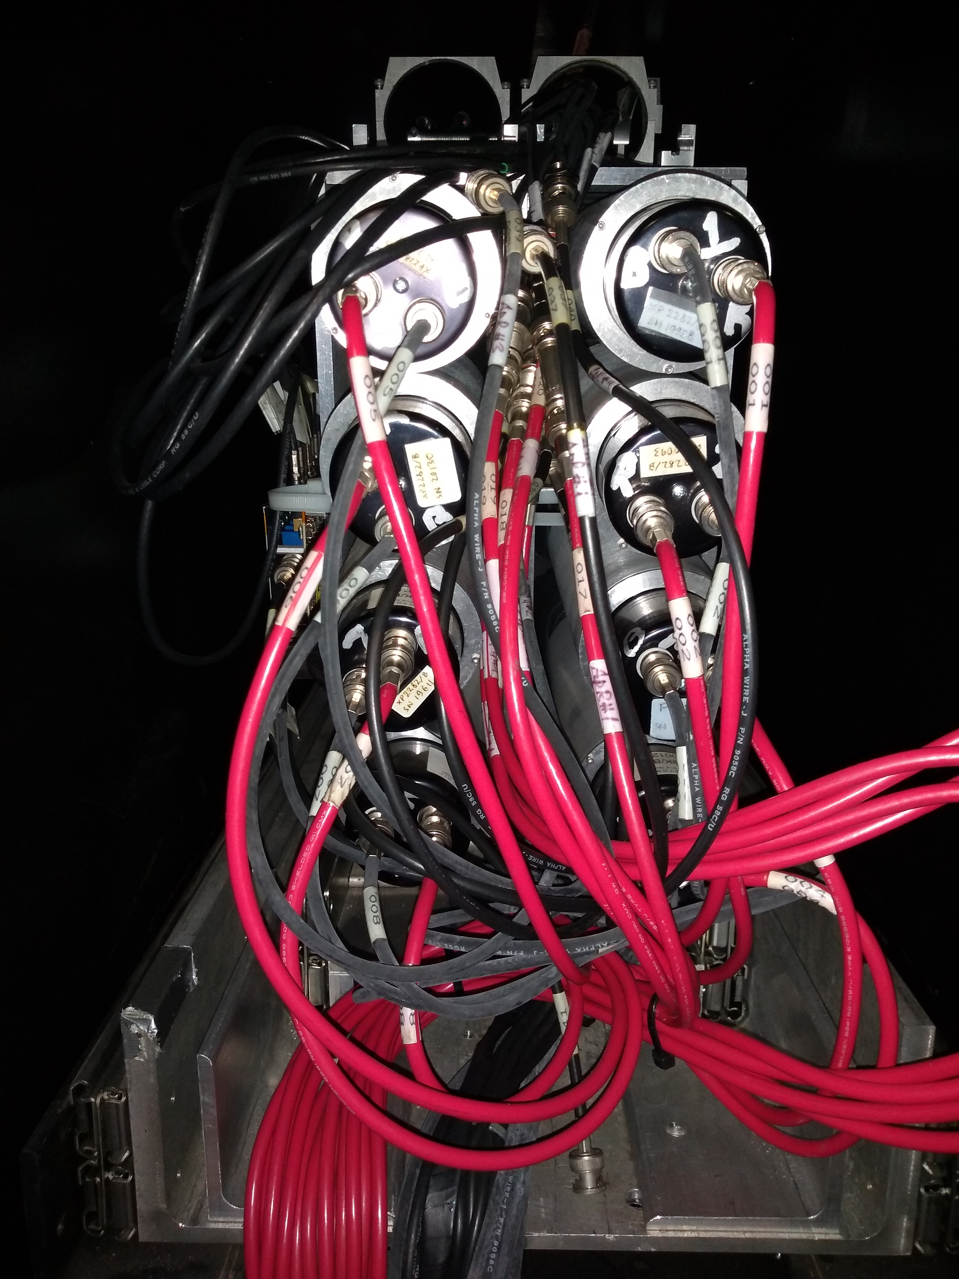
Hall A Moller Update: Detectors
Checked all PMTs few months ago and found that the PMTs attached to the scintillators exhibit behavior consistent with vacuum contamination (the calorimeter ones look good)
At the end of last year placed order for 9 R4124 PMTs (will replace before PREX)
Surveys:
To improve the accuracy of the simulation few surveys were
done in December 2018/January 2019 this month – Bill and Sanghwa were in contact with the survey group about the interpretation of the survey results

Slide 15
Hall A Moller Update: DAQ

Slide 16
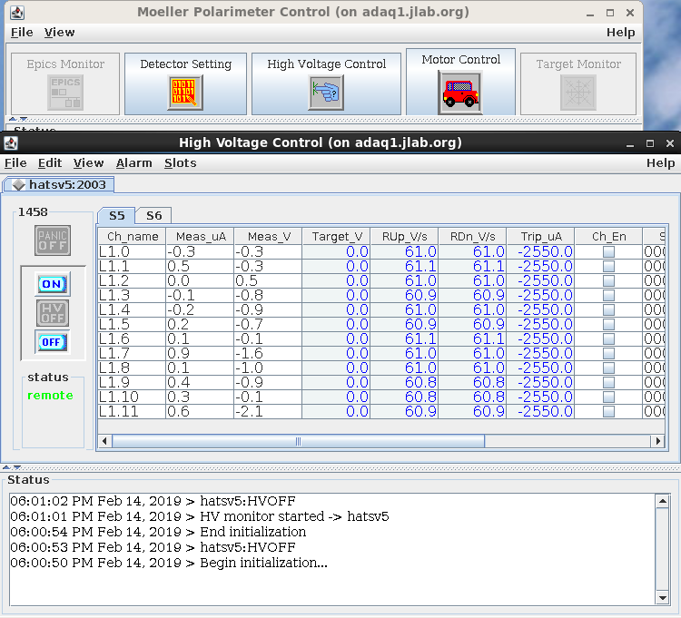
Hall A Moller Update: DAQ
High Voltages

Slide 17
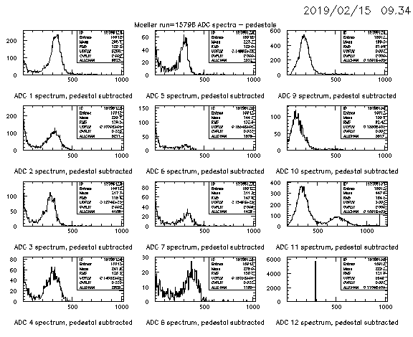
Hall A Moller Update: DAQ
High Voltages
→ Calorimeter ADC distribution should peak around 300 per block

Slide 18
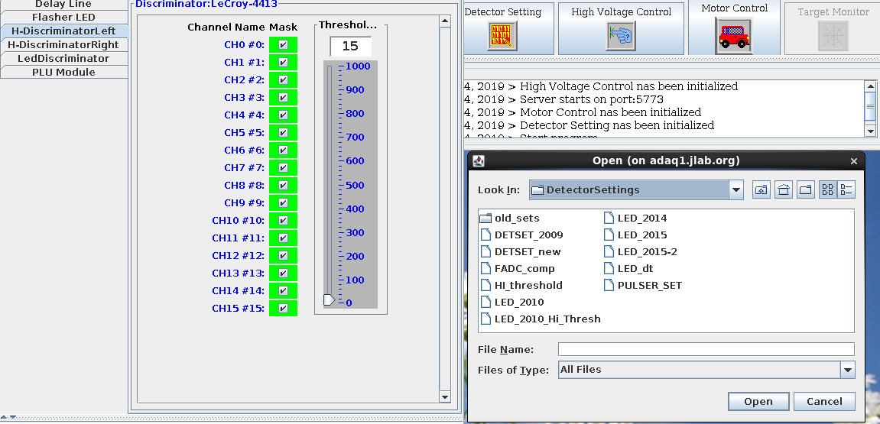
Hall A Moller Update: DAQ
Thresholds

Slide 19
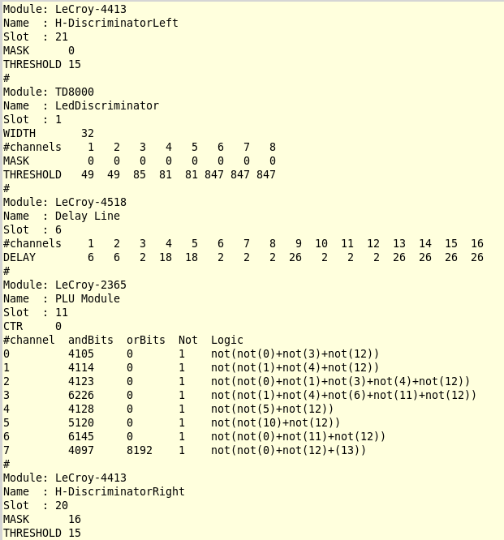
Hall A Moller Update: DAQ
Thresholds
DETSET_new file

Slide 20
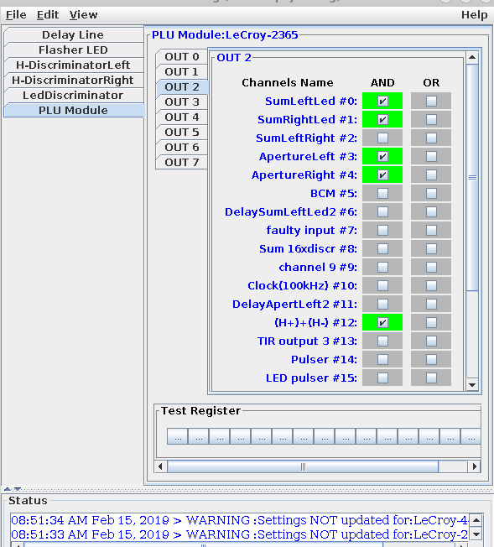
Hall A Moller Update: DAQ
PLU Configuration

Slide 21
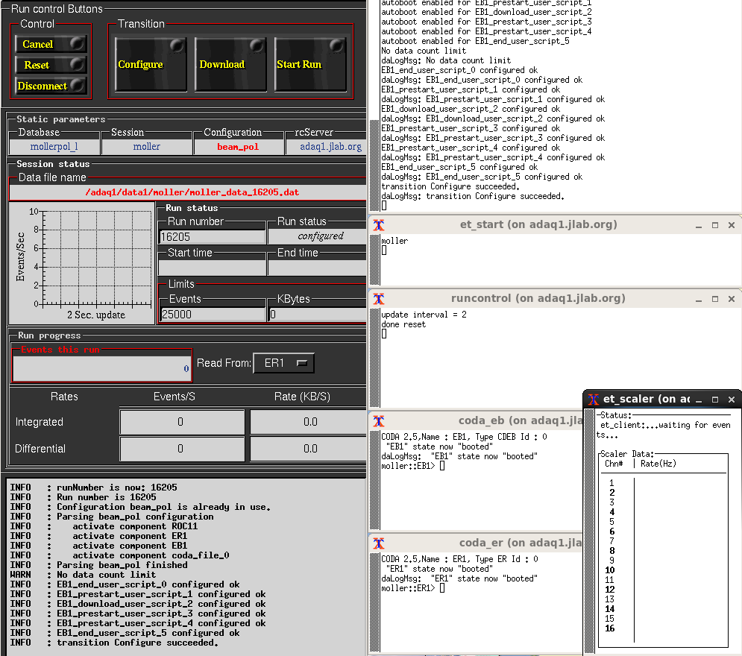
Hall A Moller Update: DAQ

Slide 22
Hall A Moller Update: Hardware/DAQ To Do
Play with the target controls during APEX downs
Check on the scope that the scintillator PMTs are gain matched when using the 2.06 GeV HV file
Take a LED run
After Commissioning:
Program a new PLU to have it as spare in case the existing one goes bad
Replace the scintillator PMTs
Add an ADC to read the scintillator channels
….

Slide 23
Hall A Polarimetry: Commissioning
Looking forward to it, I wouldn’t miss it for the world!
→ Scheduled at the end of the APEX running for 3 days
Moller Plans
Check alignment of the target magnet with beam: test developed right now by Yves
Detector gains and thresholds tuning
Check target foils centering
Check target saturation by varying the orientation of foils w.r.t. beam
Quads and Dipole scans
Holding field reversal study
See Don’s talk…

